Slide 1
Rock 'n' Roll Marathon – City Recommendation A Data-Driven Analysis for Selecting Future Host Cities
Sarvesh Dalvi u2781237

Slide 2
Agenda
What this is about: The Rock 'n' Roll Marathon is exploring potential cities for future events. This project aims to find the most suitable locations using real data and Tableau dashboards.
How it is done:
Analysed a dataset of 35 U.S. cities
Compared tourism, runner culture, climate, and affordability
Built a scoring model to rank cities based on key criteria

Slide 3
Metric Selection
What factor matters? How much?
Metric | Why it matters? | Source | Points
🏃 Marathon Finishers per 1000 | Measures active running culture | Runners World (2023) | 20
🏅 Total Running Events | Indicates city engagement & infrastructure | U.S. Travel Association (2023) | 10
🌆 Annual Leisure Visitors | Shows tourism strength & crowd potential | Statista (2024) | 10
🏨 Avg. Daily Hotel Rate | Affordability for visitors | STR Global (2023) | 10
🌡️ Avg. April Temps | Runner comfort zone = 50–65°F | Vihma, 2010 | 20
📍 Proximity to RnR Cities | Avoids overlap, supports market expansion | U.S. Travel Association (2023) | 10
👥 Metro Area Population | Bigger base for participants & support | U.S. Travel Association (2023) | 10
🛍️ Running Stores | Reflects local running ecosystem | Runners World (2023) | 10

Slide 4
Data Cleaning
Keeping it clean:
Techniques used:
Not all cities have complete data. For example, Raleigh had many missing values and was excluded from scoring
ZN() was used to replace nulls with zeros
Scaled big values (like visitors) to comparable units
Removed cities with unreliable or empty data (Raleigh)
The idea was to keep the analysis fair and avoid skewed results.

Slide 5
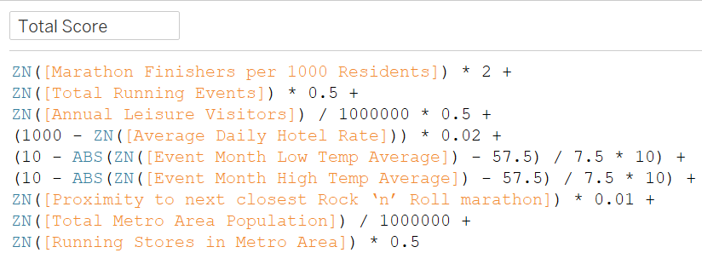
Scoring Model
How scores were calculated: Each city got points across multiple areas. Here's the formula:
(Runners) * 2 +
(Events) * 0.5 +
(Visitors / 1M) * 0.5 +
(Hotel Cost reversed) +
(Weather idealness) +
(Distance from RnR cities) +
(Population) +
(Running stores) * 0.5
Everything was scaled and weighted to keep things balanced.

Slide 6
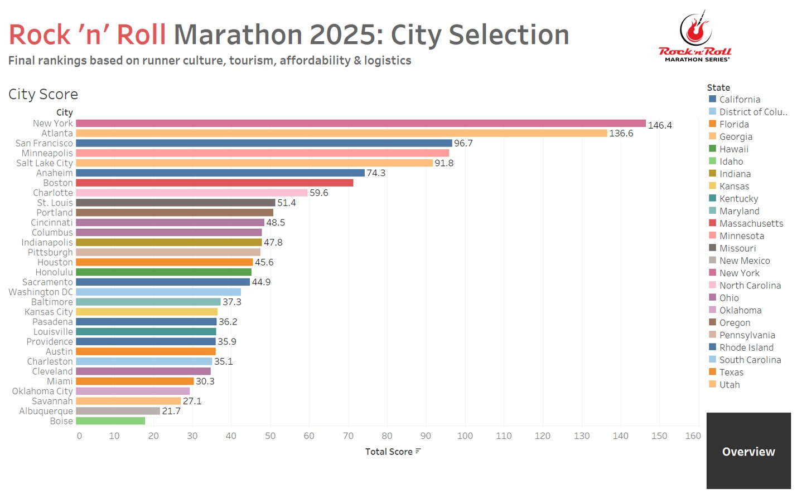
Final Dashboard
What I found:

Slide 7
Final Recommendation These three offer the best balance for future RnR events.
New York
Massive Tourism
Atlanta
Affordable
San Francisco
Strong running culture
Scenic appeal
Active Runners
Strong infrastructure
Good weather
High participants
🥇
🥈
🥉

Slide 8
Limitations
Some cities had missing or outdated data
Climate was based on averages, not actual 2025 forecasts
Other real-world factors (permits, local support) weren’t included
Rankings may shift over time

Slide 9
References
Runners World (2023) Best running cities in America. Available at: https://www.runnersworld.com/runners-life/g20843720/best-running-cities-in-america/
Statista (2024) Most visited cities in the United States. Available at: https://www.statista.com/statistics/
STR Global (2023) Hotel industry performance metrics: ADR and occupancy. Available at: https://str.com/data-insights
U.S. Travel Association (2023) Event impact toolkit: Assessing economic value of sports events. Available at: https://www.ustravel.org/
Vihma, T. (2010) ‘Effects of weather on marathon running performance’, International Journal of Biometeorology, 54(3), pp. 297–306. Available at: https://pubmed.ncbi.nlm.nih.gov/24191965/

Slide 10
Thank you
Sarvesh Dalvi
Dashboard link : https://public.tableau.com/views/RnRPotentialCities/RnRCityRecommendation?:language=en-US&:sid=&:redirect=auth&:display_count=n&:origin=viz_share_link

